Slide 1
Flashcard web application
By: Ishi Agrawal, Tedy Barber, and Dominique Bornilla

Slide 2
Introduction to the project
Purpose: To create a web application that helps students study with flashcards created by them or their teachers
Features:
Be able to create, edit, and delete a study set of flashcards
Be able to register the teacher(s) and their students using the flashcards via their school information only (i.e. School Email)
Be able to create “classrooms” with all registered students from each section of the teacher’s classes
Be able to set flashcards aside that they get wrong and study those from the flashcard set
Be able to have 2 students from the class interact and study with each other
Tools and Technologies used: HTML, CSS, JS, PHP, Heroku Postgres

Slide 3
Team Members’ Roles and Responsibilities
Team Point of Contact with Dr.Nelson and CS department : Tedy Barber
Team Point of Contact with the Client : Ishi Agrawal
Development, Report Writing, Poster Creation, Presenting, etc :
Split evenly between all 3 team members

Slide 4
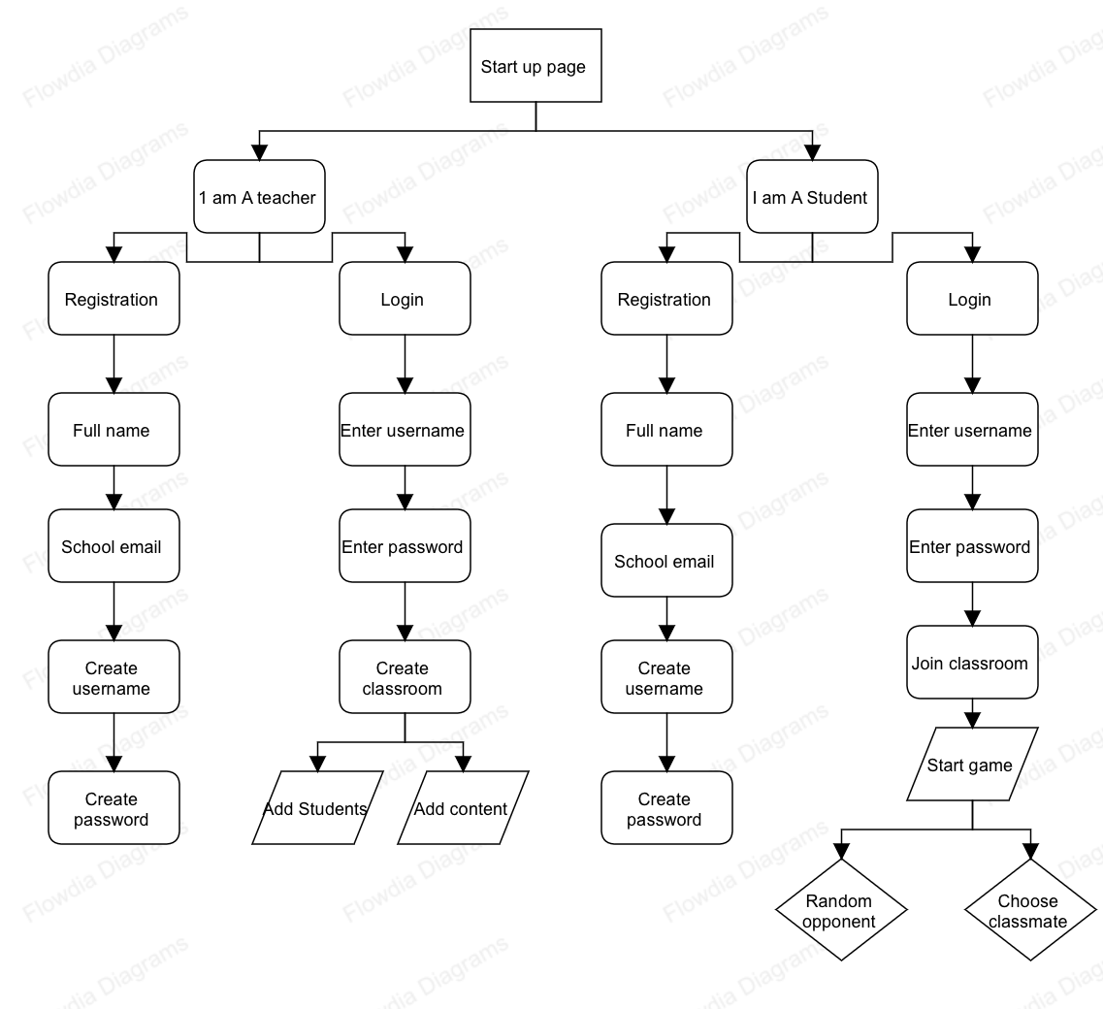
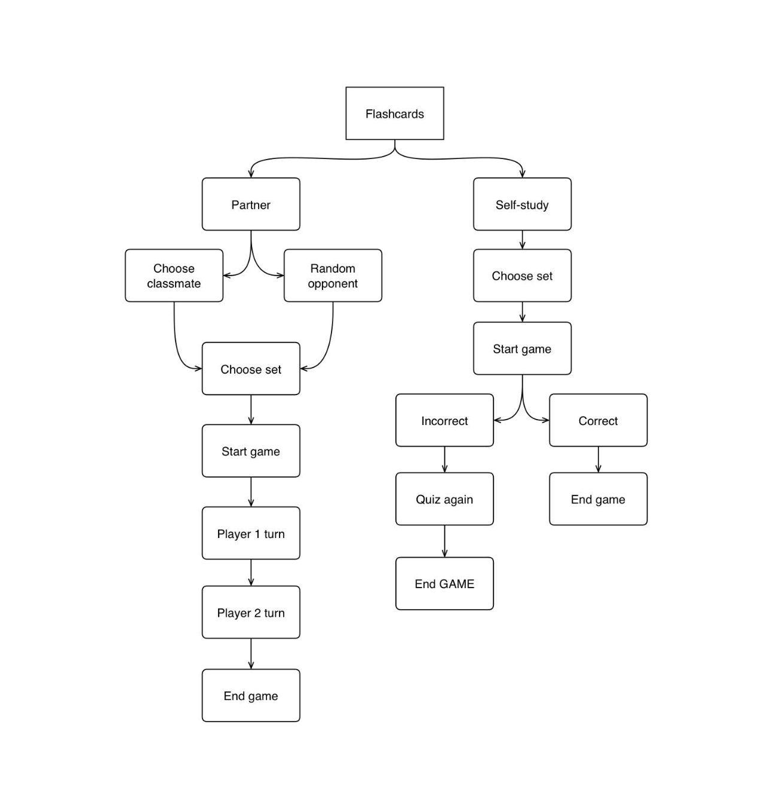
Flow Chart of Application

Slide 5
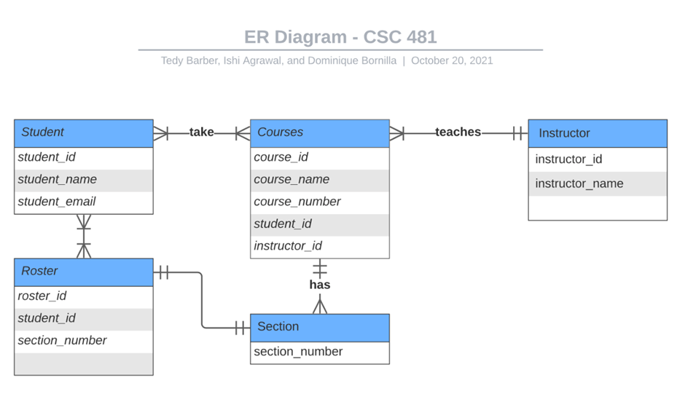
Entity Relationship Diagram (ERD) of Application Database

Slide 6
Working with the Client
Project Client: Timothy Koontz
Role: Science Teacher at Timberline High School
Email: tkoontz@nthurston.k12.wa.us
Incorporating Client’s wishes into project requirements:
Since quizlet does not have the ability to set aside flashcards from a study set to study from, client offered the idea to create the feature that allows students to set flashcards aside that they get wrong and study those from the set

Slide 7
Potential Technical and Qualitative Restraints
A restraint is the technical requirement of the features wanting to be implemented. This will require in depth use of Javascript and PHP that we have not ever worked with.
In case features 4 or 5 (below) prove too difficult to implement, the most feasible will be implemented
Be able to set flashcards aside that they get wrong and study those from the flashcard set
Be able to have 2 students from the class interact and study with each other

Slide 8
Other Potential Risks and Solutions
Reducing Security Risks :
We do not keep any student/teacher information besides their school issued email ID and the classes they are enrolled in. Personal emails will not be allowed. No information about a person's age, date of birth, social security, or linking of outside social media accounts will be involved.
PASSWORDS:
People will be encouraged to keep passwords that are not related to their financial or other sensitive accounts.
If someone wants to continue using this project, they can implement a feature to change teachers’ passwords every 6 months for security

Slide 9
Schedule
Status | Not started
Objective | Create front end design and set up front end
Activity dates | Planned: December – January
Status | Not started
Objective | Set up the database to match the requirements
Activity dates | Planned: January
Front End User Interface
Back End Database Setup
Build Out Application
Status | Not started
Objective | Code the application logic
Activity dates | Planned: Mid-January - end of March

Slide 10

Budget
The only associated cost will be to host the database and application on a website so that the teacher(s) and students can access and use the site freely.
We plan to use Heroku hosting services, which have free options for hosting if using a student/hobby app and a heroku postgres data storage. Free hosting will be used first, and if needed, paid hosting will be used. This cost will be covered by the School of Engineering.

Slide 11

Next Steps
When this project is fully implemented, the hope is that the teacher incorporates this as a study tool, hw, or classroom assignment for the students to study with.

Slide 12
Thank You

